Slide 2
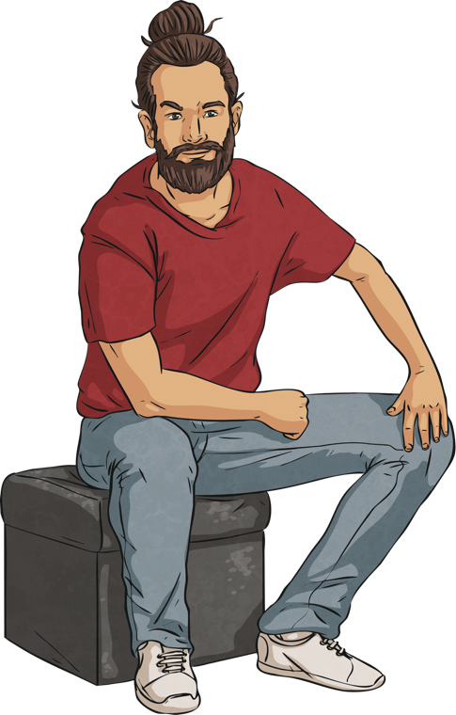
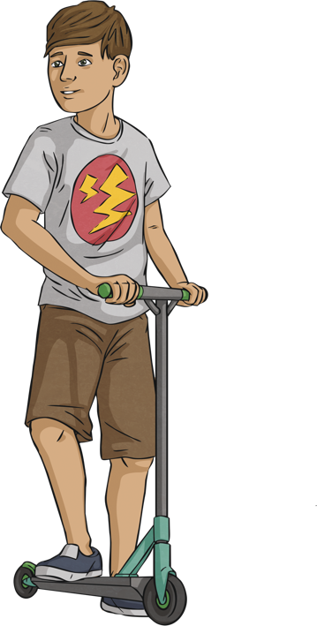
Can You Guess…
First Conditional
What are their names?
Which one is the father and which one is the son?
Where are they from?
What do they like doing?
Which one is adventurous?

Slide 3
First Conditional
I’m going on an adventure! I’m going to the USA for a month. I’m going alone, and I’m going to camp. I have $500 in total, so I can spend $16 a day. I’m so excited for my trip!
I don’t know if you’re ready. In fact, I think you’re going to have a lot of problems! So before I let you go, you have to answer my questions.
If your answers aren’t good enough, you’ll have to stay at home!
OK, Dad…

Slide 4
First Conditional
What will you do if you get lost?
If I get lost, I’ll ask someone where I am.

Slide 5
First Conditional
What will you do if you run out of money?
If I run out of money, I’ll call you and you’ll send me more.

Slide 6
First Conditional
What will you do if you lose your passport?
If I lose my passport, I’ll go to the embassy.

Slide 7
First Conditional
Where will you sleep if you lose your tent?
If I lose my tent, I won’t sleep outside. I’ll stay at a youth hostel.

Slide 8
First Conditional
Where will you go if you get sick?
If I get sick, I’ll go to the hospital.

Slide 9
First Conditional
What will you do if you can’t call me?
If I can, I’ll call you from a friend’s phone.

Slide 10

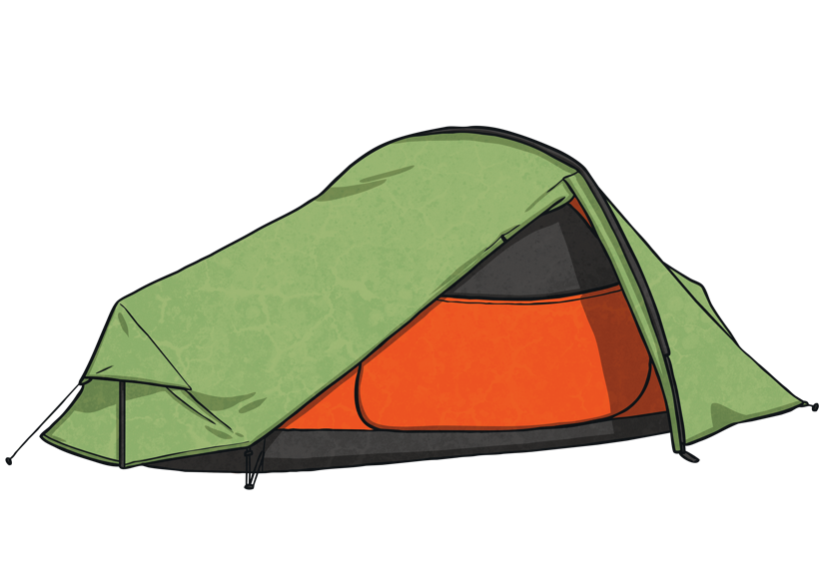
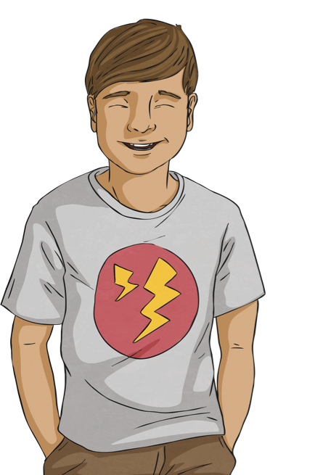
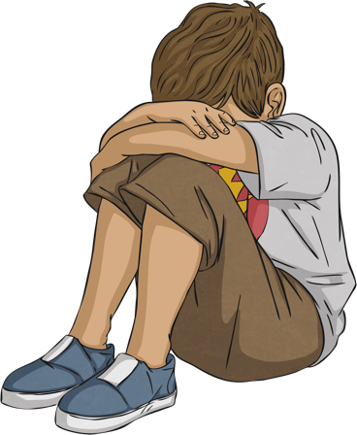
First Conditional
What do you think? Is he ready for his adventure?
Yes
No
Yes
Yes

Slide 11
Examine The Sentence
First Conditional
If I get lost, I’ll ask someone where I am.
Are we talking about the past, present or future?
Are we talking about something that will definitely happen, or might happen?
What tenses can you see?
What connecting word can you see?
What contraction can you see?
What punctuation can you see?
future
It might happen.
present, future
if
I will = I’ll
comma, full stop

Slide 12
First Conditional
If I get lost, I’ll ask someone where I am.
Affirmative Form
(If + present simple), (future)
(future) (if + present simple)
Question Form
you do if you get lost?
you ask someone where you are if you get lost?
Negative Form
If I know where I am, I’ll ask someone.
If I get lost, I panic.

Slide 13
Ready to Practise?
First Conditional
Match the beginnings and ends of the sentences.
If we get tired,
We’ll take a coat,
Where will you go to university,
Who will help you,
If you get home early,
If it’s raining tomorrow,
If I can’t see the film at the cinema,
If we don’t know the answer,
I’ll watch it next year.
if you don’t pass your exams?
if you get stuck?
we won’t stay out late.
we’ll ask the teacher.
I won’t go for a run in the park.
will you make me dinner?
if it’s cold and rainy.
we won’t stay out late.
if it’s cold and rainy.
if you don’t pass your exams?
if you get stuck?
will you make me dinner?
I won’t go for a run in the park.
I’ll watch it next year.
we’ll ask the teacher.

Slide 14
Your Turn!
First Conditional
Imagine you’re a parent. Your daughter/son wants to go to a concert with her/his friends. What ‘if’ questions can you ask? Write down six questions.
Now ask and answer your questions.
Do you think your son or daughter can go to the concert?

